Slide 1
Leader – Employee Problem
Finding the Leader
Nikolay Dimitrov

Slide 2
The Problem
Task: Write a program which finds the direct leader of two employees
Input data:
First line: first employee ’s name
Second line: second employee ’s name
Third line: hierarchical pairs leader-employee
Conditions:
Each leader has up to two employees
Each employee has only one leader
The first pair always contains leader of the highest rank

Slide 3
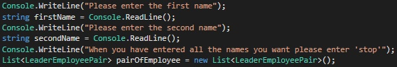
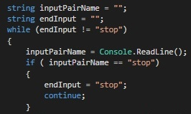

Logical steps 1
Taking the input data and adding it to a List<T>
Declaring two strings and a while loop that is
used to initialize the pairs
An array, part of the while loop, that separates the input pairs

Slide 4

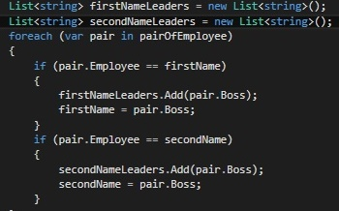

Logical steps 2
A method which reverses the original
positions of the items in the list
Iterating and extracting leader’s names from the reversed
the list and recording them in two collections.
Overwriting the first and second name
A method that compares and finds identical
in the two collections

Slide 5
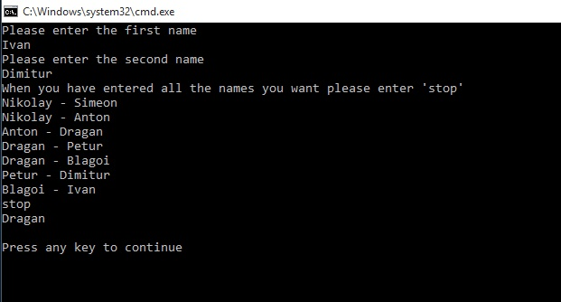
Input / Output
Sample Input Expected Output
Ivan Dragan
Dimitur
Nikolay – Simeon
Nikolay – Anton
Anton – Dragan
Dragan – Petur
Dragan – Blagoi
Petur – Dimitur
Blagoi – Ivan
stop

Slide 6
Thank you and if you have any questions, please don’t hesitate to ask

